Slide 1
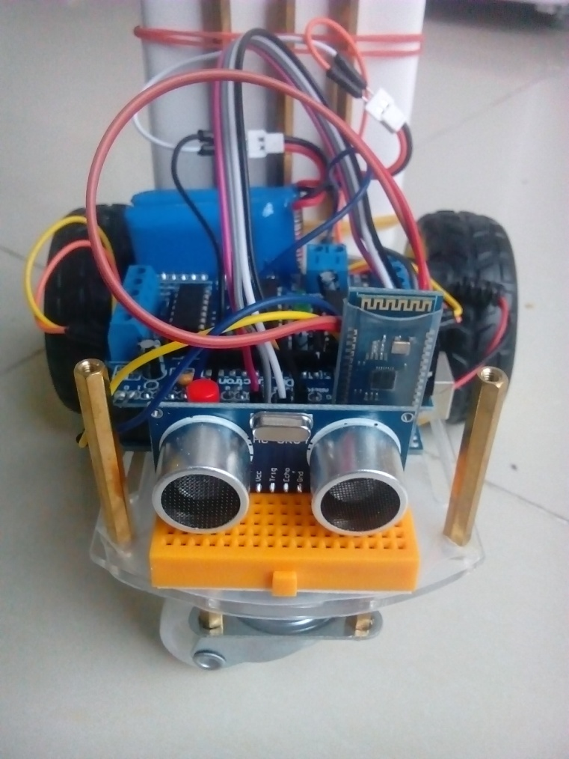
Aicar
for AI projects

Slide 2
outline
About Aicar
Hardware Compents
Software Compents
Functions
Interfaces
Applications

Slide 3
Aicar
In computer science, the field of AI research defines itself as the study of "intelligent agents": any device that perceives its environment and takes actions that maximize its chance of success at some goal.
Aicar is an inexpensive (~ 50￥) intelligent agent for carrying out research projects in artificial intelligence. With Aicar, you can test different AI algorithms and policies for conducting actions based on various sensors input.

Slide 4
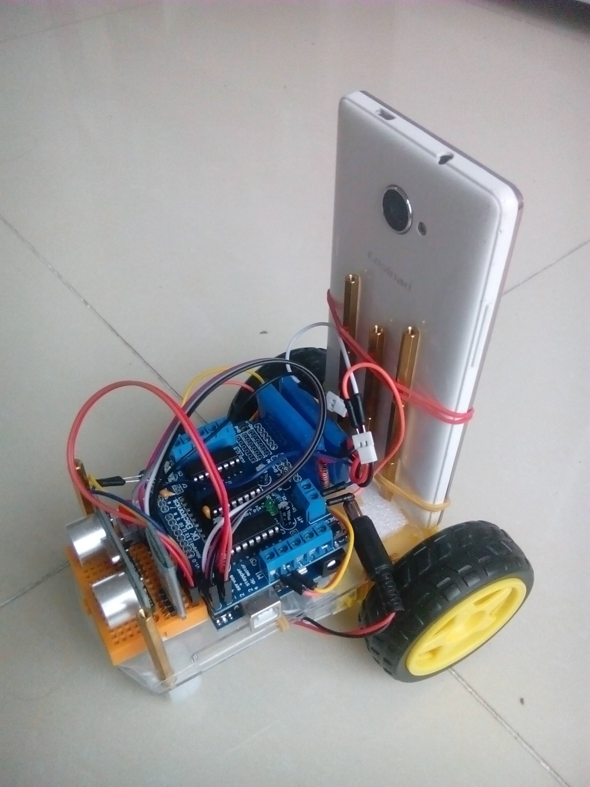
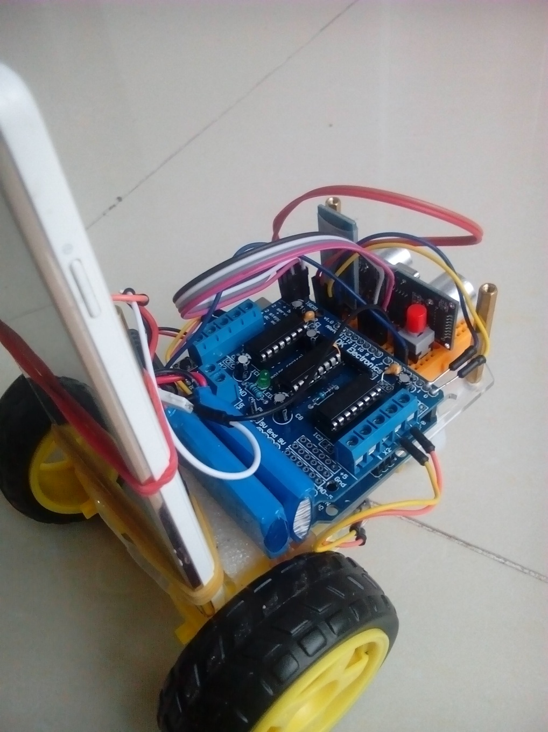
Aicar Hardware

Slide 5
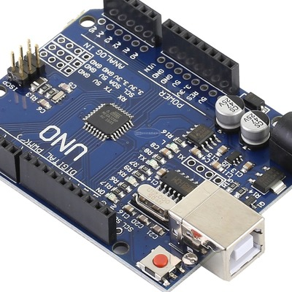
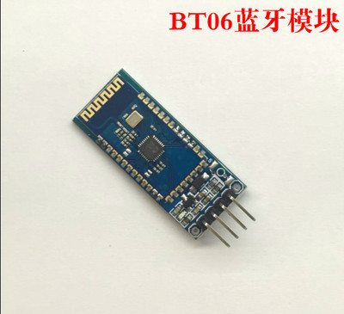
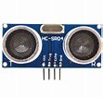
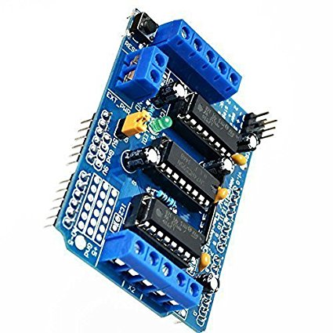
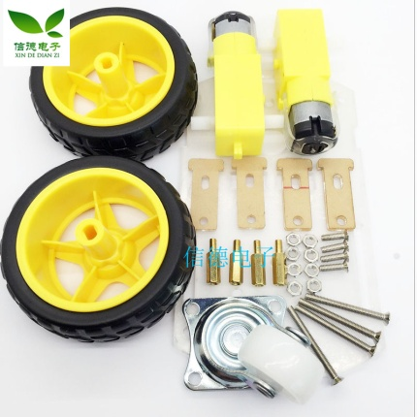
Hardware Compents
Arduino UNO
BT06 Bluetooth
HC-SR04 Ultrasonic Distance Measuring
L293D Motor Drive Shield
2WD Smart Robot Car Chassis Kit
Notes:
an inexpensive two-wheeled differentially-steered robot based on the popular Arduino Uno compatible microcontrollers

Slide 6
Software Compents
Video Capture Tools
DroidCam for Android
DroidCam Client for Win/Linux
Development
Arduino IDE (C/C++)
Matlab
Python

Slide 7
Functions
Bluetooth

Slide 8
Interfaces - Matlab

Slide 9
Interfaces - Python

Slide 10
Applications

Slide 11
References
Arduino.cc — Introduce microcontroller used in this project, get project ideas, and learn programming tips, Arduino is a very popular and relatively inexpensive way to do projects with microcontrollers. •
Taobao.com — All stuff used, including Arduino Uno, DC motors, sensors and more. A corresponding components reference list for the Aicar hardware is attached.

Slide 12
Aicar components list
For reference only

Slide 13
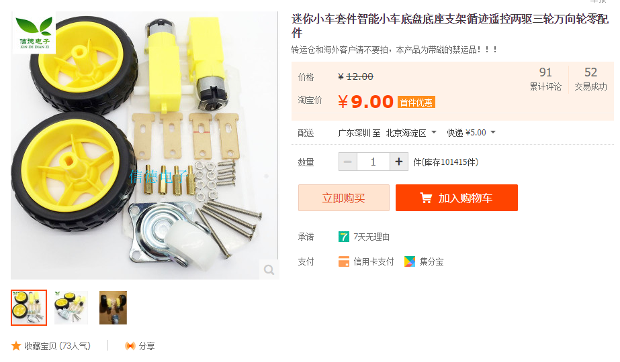

Slide 14
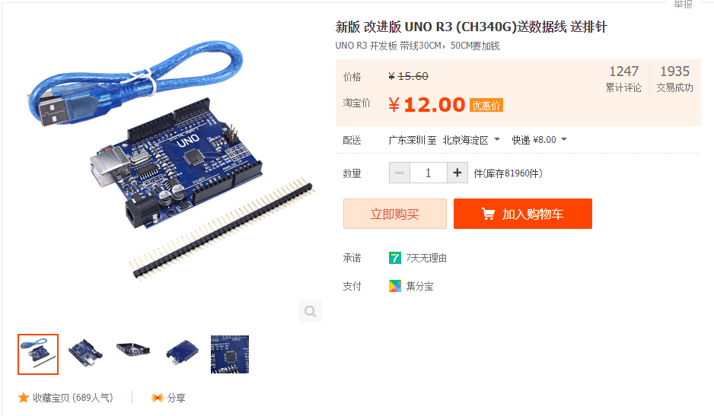

Slide 15
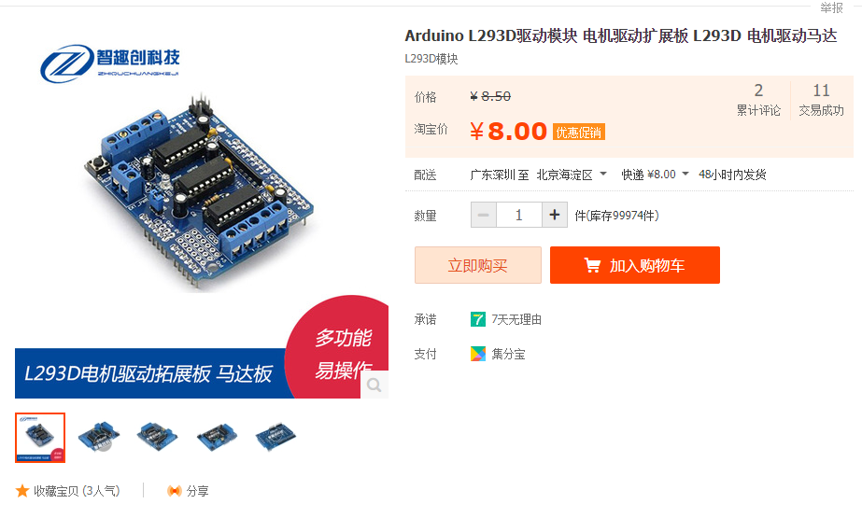

Slide 16
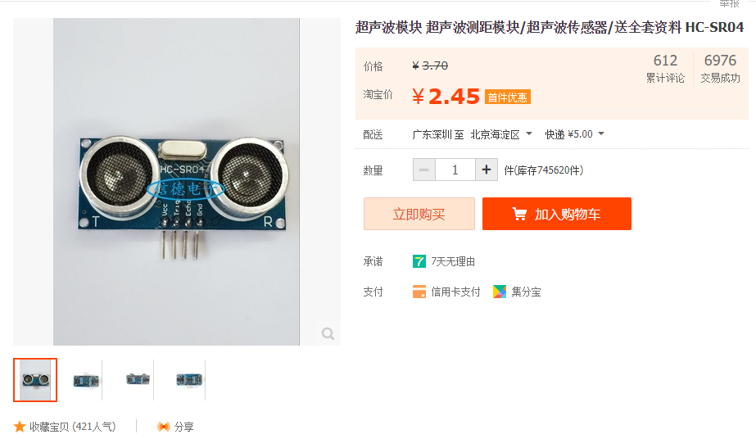

Slide 17
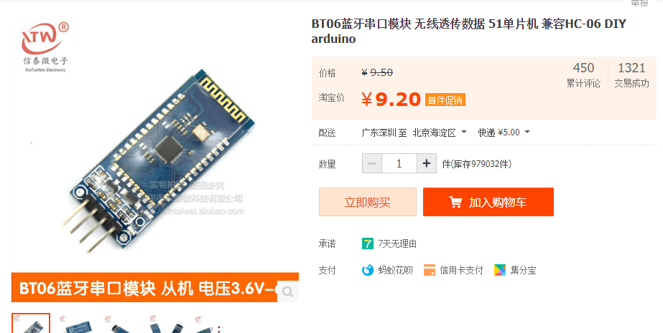

Slide 18
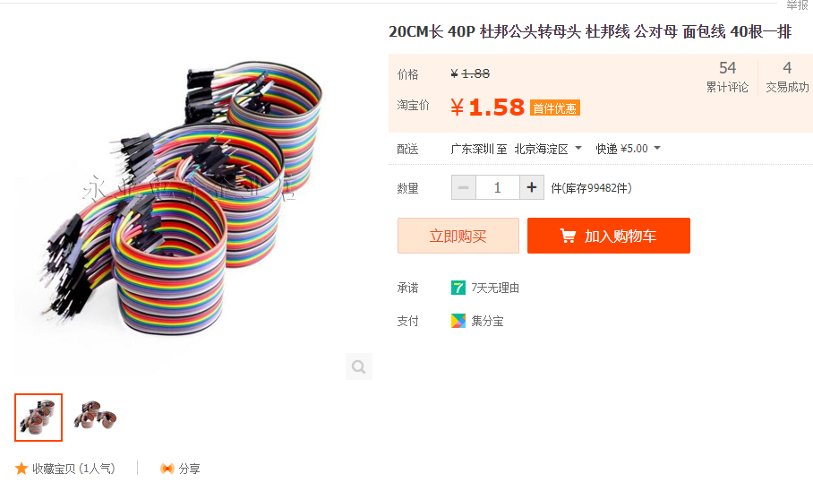

Slide 19
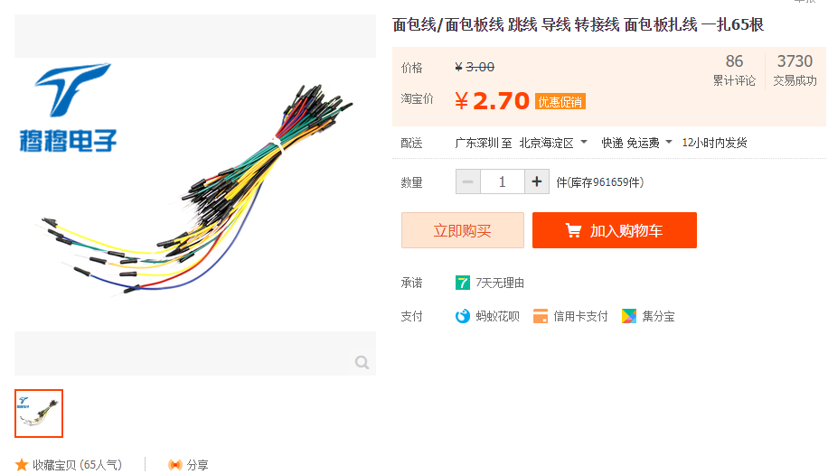

Slide 20


Slide 21
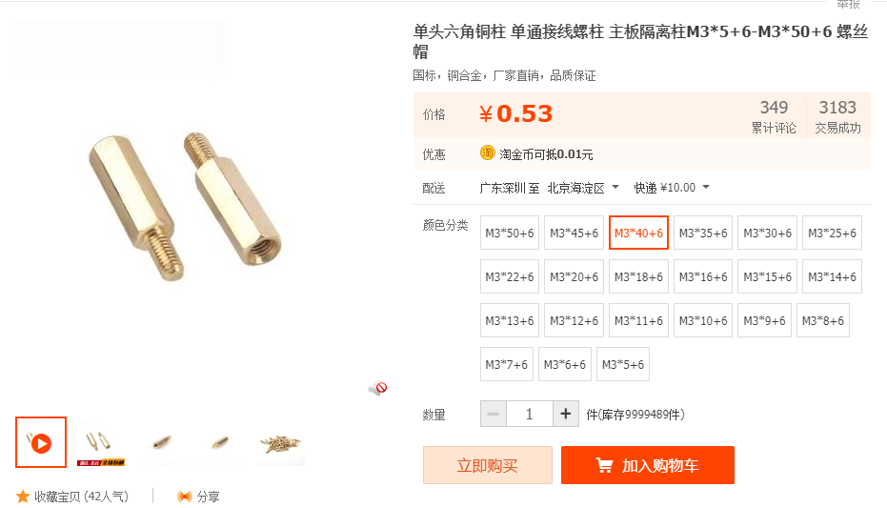

Slide 22

Notes:
power bank (充电宝) is preferred.

Slide 23
